Slide 1

23MT919
INTRODUCTION TO MACHINE LEARNING
Basics of Neural Network - Backpropagation - Minimization of cost function and Gradient Descent

Slide 2
Nervous system
Machine learning, as we have seen, mimics the human form of learning. On the other hand, human learning, or for that matter every action of a human being, is controlled by the nervous system
Human being, the nervous system coordinates the different actions by transmitting signals to and from different parts of the body. The nervous system is constituted of a special type of cell, called neuron or nerve cell, which has special structures allowing it to receive or send signals to other neurons. Neurons connect with each other to transmit signals to or receive signals from other neurons.
This structure essentially forms a network of neurons or a neural network

Slide 3
UNDERSTANDING THE BIOLOGICAL NEURON
The human nervous system has two main parts – the central nervous system (CNS) consisting of the brain and spinal cord the peripheral nervous system consisting of nerves and ganglia outside the brain and spinal cord.
1. Dendrites – to receive signals from neighbouring neurons.
2. Soma – main body of the neuron which accumulates the signals coming from the different dendrites. It ‘fires’ when a sufficient amount of signal is accumulated.
3. Axon – last part of the neuron which receives signal from soma, once the neuron ‘fires’, and passes it on to the neighbouring neurons through the axon terminals (to the adjacent dendrite of the neighbouring neurons).
There is a very small gap between the axon terminal of one neuron and the adjacent dendrite of the neighbouring neuron. This small gap is known as synapse. The signals transmitted through synapse may be excitatory or inhibitory.

Slide 4
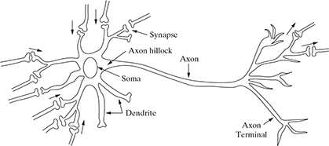
Structure of biological neuron

Slide 5
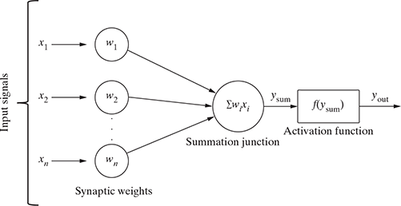
Structure of an artificial neuron

Slide 6


A summation junction

Slide 7
TYPES OF ACTIVATION FUNCTIONS
Identity function
Threshold/ step function
Rectified linear unit function
Sigmoid function
Binary sigmoid function
Bipolar sigmoid function
Hyperbolic tangent function

Slide 8
TYPES OF ACTIVATION FUNCTIONS
Identity function
Identity function is used as an activation function for the input layer. It is a linear function having the form

Slide 9

Threshold/step function
Step/threshold function is a commonly used activation function step function gives 1 as output if the input is either 0 or positive.
If the input is negative, the step function gives 0 as output. Expressing mathematically,

Slide 10
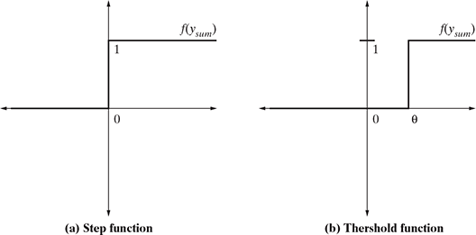
Step and threshold functions

Slide 11

Threshold function
The threshold function (depicted in Figure) is almost like the step function, with the only difference being the fact that θ is used as a threshold value instead of 0. Expressing mathematically

Slide 12
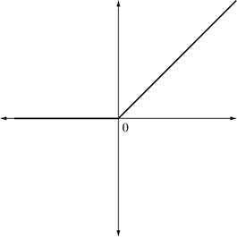

ReLU (Rectified Linear Unit) function
ReLU is the most popularly used activation function in the areas of convolutional neural networks and deep learning. It is of the form

Slide 13
Sigmoid function
Sigmoid function, is by far the most commonly used activation function in neural networks.
The need for sigmoid function stems from the fact that many learning algorithms require the activation function to be differentiable and hence continuous.
Step function is not suitable in those situations as it is not continuous.
There are two types of sigmoid function: Binary sigmoid function and Bipolar sigmoid function

Slide 14

Binary sigmoid function
A binary sigmoid function
where k = steepness or slope parameter of the sigmoid function. By varying the value of k, sigmoid functions with different slopes can be obtained. It has range of (0, 1).
The slope at origin is k/4. As the value of k becomes very large, the sigmoid function becomes a threshold function

Slide 15
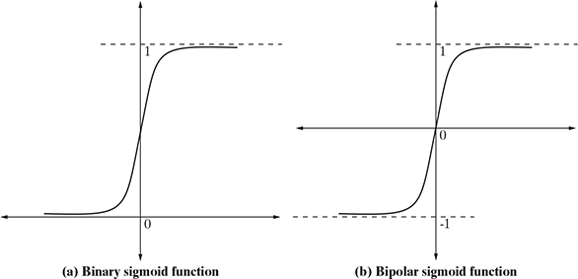
Sigmoid function

Slide 16

Bipolar sigmoid function
A bipolar sigmoid function
The range of values of sigmoid functions can be varied depending on the application. However, the range of (−1, +1) is most commonly adopted.

Slide 17


Hyperbolic tangent function
Hyperbolic tangent function is another continuous activation function, which is bipolar in nature. It is a widely adopted activation function for a special type of neural network known as backpropagation network

Slide 18
Early Implementations of ANN
McCulloch-Pitts Model of Neuron
Rosenblatt’s Perceptron
Multilayer Perceptron
ADALINE Network Model

Slide 19
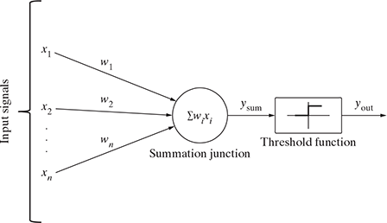
McCulloch–Pitts neuron

Slide 20
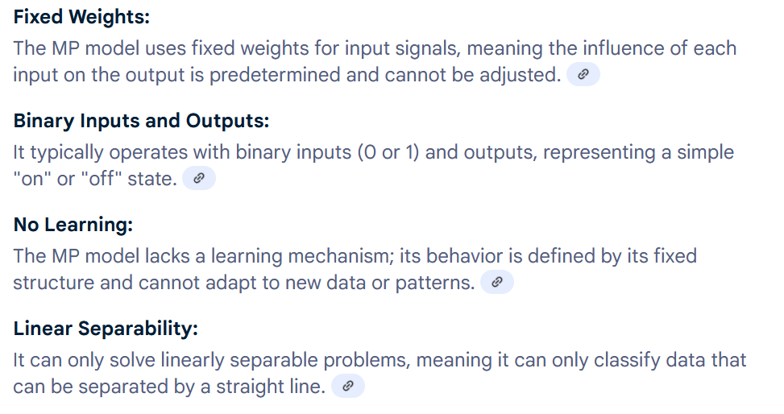
McCulloch–Pitts Model

Slide 21
McCulloch–Pitts model of neuron
The McCulloch–Pitts neural model, which was the earliest ANN model, has only two types of inputs – excitatory and inhibitory. The excitatory inputs have weights of positive magnitude and the inhibitory weights have weights of negative magnitude.
The inputs of the McCulloch–Pitts neuron could be either 0 or 1. It has a threshold function as activation function. So, the output signal y_{out} is 1 if the out input y_{sum} is greater than or equal to a given threshold sum value, else 0.
Simple McCulloch–Pitts neurons can be used to design logical operations. For that purpose, the connection weights need to be correctly decided along with the threshold function (rather the threshold value of the activation function)

Slide 22
Example
John carries an umbrella if it is sunny or if it is raining.
Situation 1 – It is not raining nor is it sunny.
Situation 2 – It is not raining, but it is sunny.
Situation 3 – It is raining, and it is not sunny.
Situation 4 – Wow, it is so strange! It is raining as well as it is sunny

Slide 23
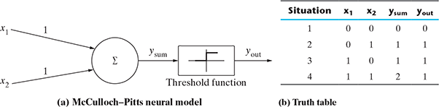

x₁ → Is it raining?
x₂ → Is it sunny?

Slide 24
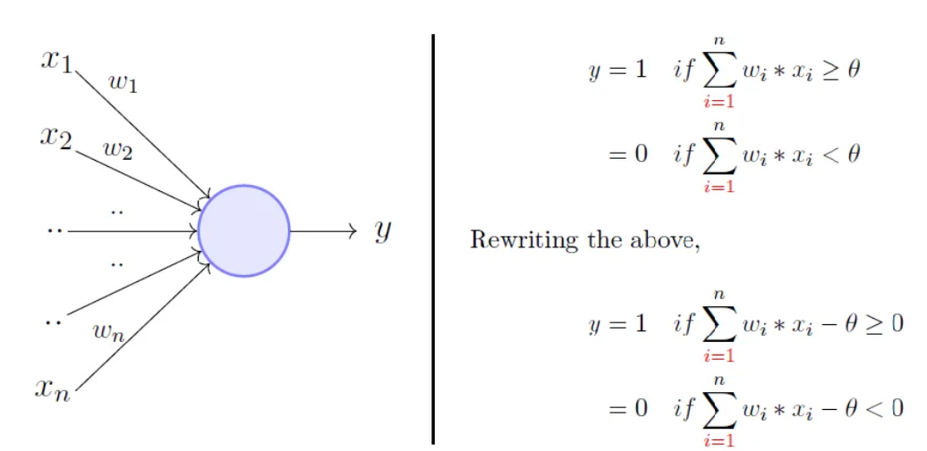
Rosenblatt’s Perceptron Model
Rosenblatt’s perceptron is built around the McCulloch– Pitts neural model.

Slide 25
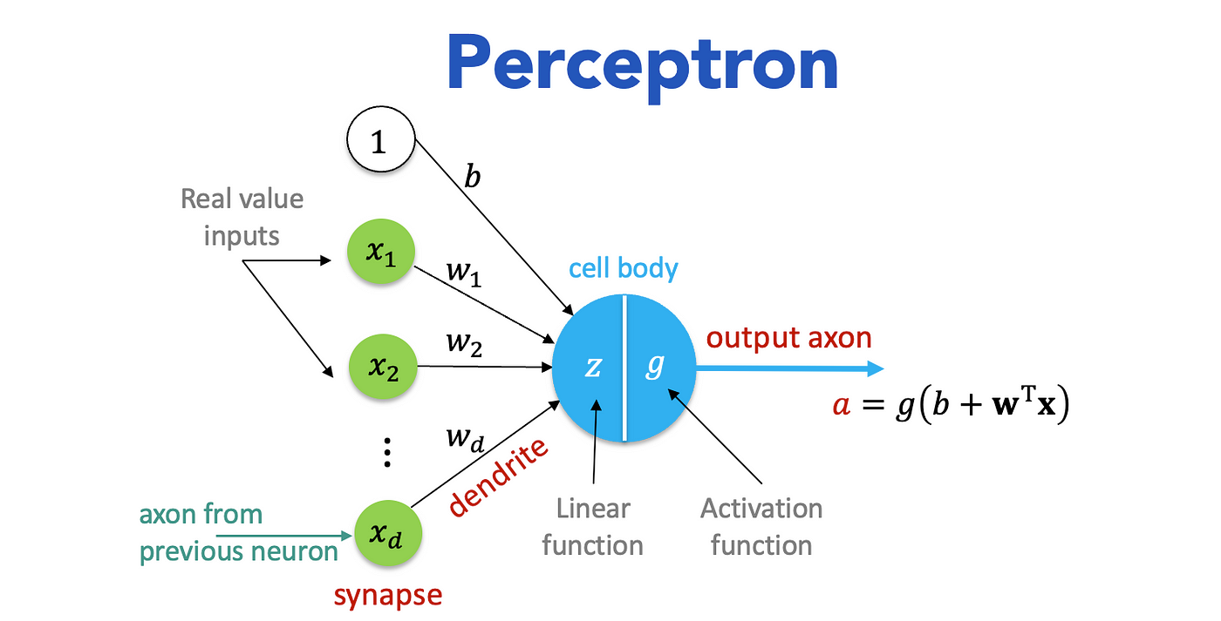

Slide 26
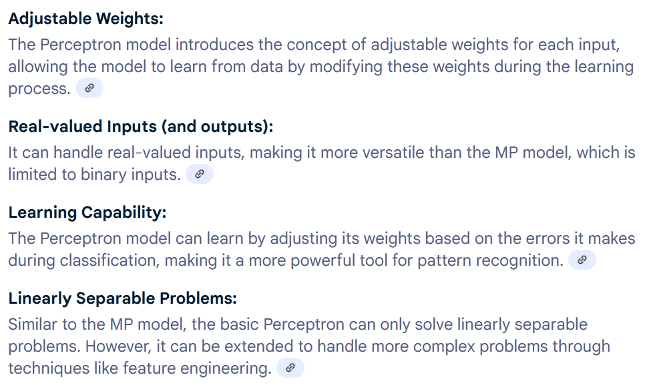
Rosenblatt’s Perceptron Model

Slide 27
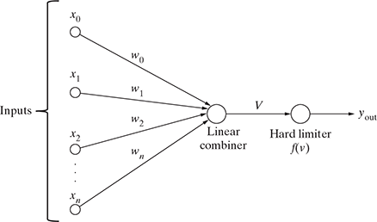

Rosenblatt’s Perceptron Model

Slide 28
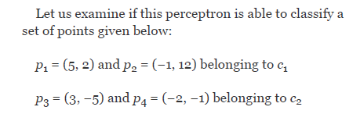
Rosenblatt’s Perceptron Model

Slide 29
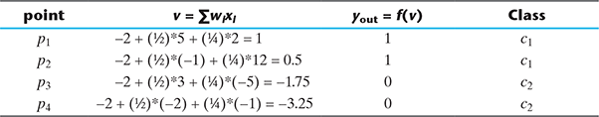
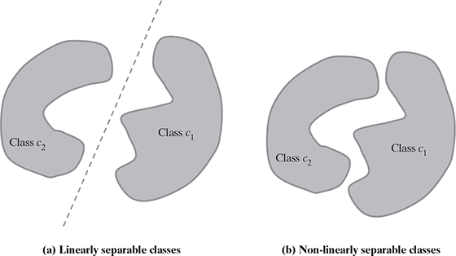
Rosenblatt’s Perceptron Model

Slide 30
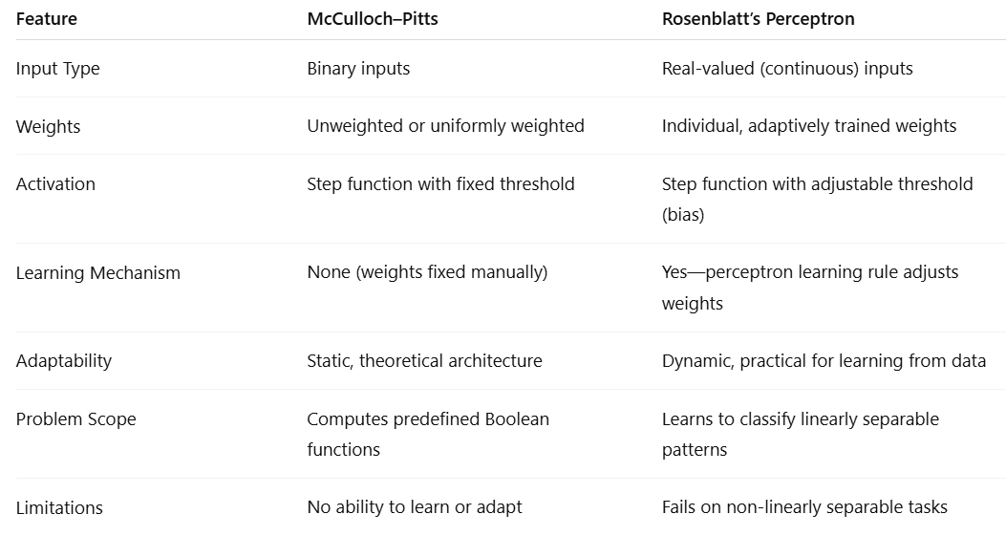

Slide 31
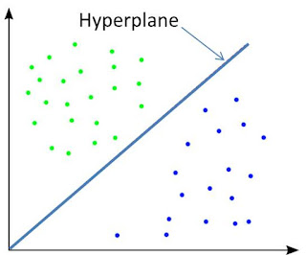
Linear Separability
Linear separability is the concept wherein the separation of the input space into regions is based on whether the network response is positive or negative.
When the two classes are not linearly separable, it may be desirable to obtain a linear separator that minimizes the mean squared error.
Definition : Sets of points in 2-D space are linearly separable if the sets can be separated by a straight line.
Generalizing, a set of points in n-dimensional space are linearly separable if there is a hyper plane of (n-1) dimensions separates the sets.

Slide 32
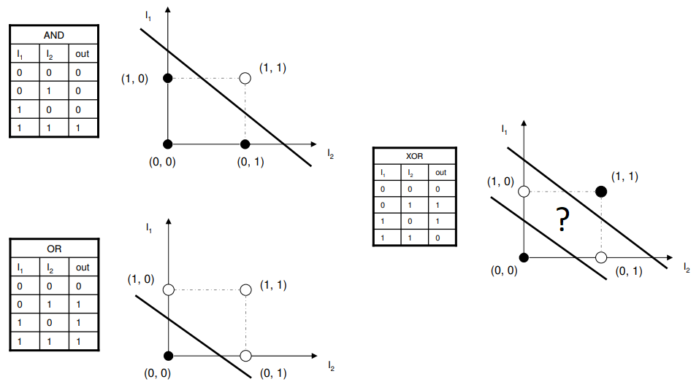

Slide 33
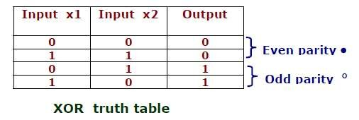
·
·
Even parity means even number of 1 bits in the input
Odd parity means odd number of 1 bits in the input

Slide 34
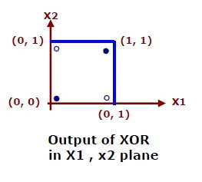
·
There is no way to draw a single straight line so that the circles are on
one side of the line and the dots on the other side.
Perceptron is unable to find a line separating even parity input patterns from odd parity input patterns.
·

Slide 35
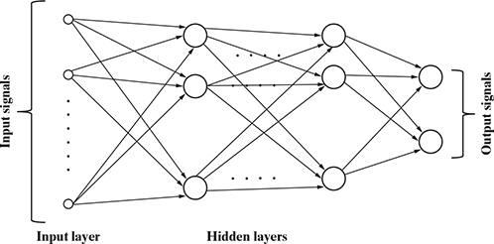
Multi-layer Perceptron

Slide 36
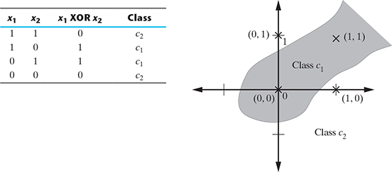
Multi-layer Perceptron
A basic perceptron works very successfully for data sets which possess linearly separable patterns. However, in practical situation, that is an ideal situation to have. This was exactly the point driven by Minsky and Papert in their work (1969). They showed that a basic perceptron is not able to learn to compute even a simple 2-bit XOR.

Slide 37
ADALINE Network Model
Adaptive Linear Neural Element (ADALINE) is an early single-layer ANN developed by Professor Bernard Widrow of Stanford University.
The supervised learning algorithm adopted by the ADALINE network is known as Least Mean Square (LMS) or Delta rule.
A network combining a number of ADALINEs is termed as MADALINE (many ADALINE). MADALINE networks can be used to solve problems related to nonlinear separability.

Slide 38
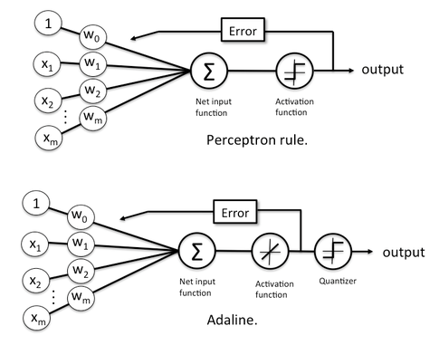

Slide 39
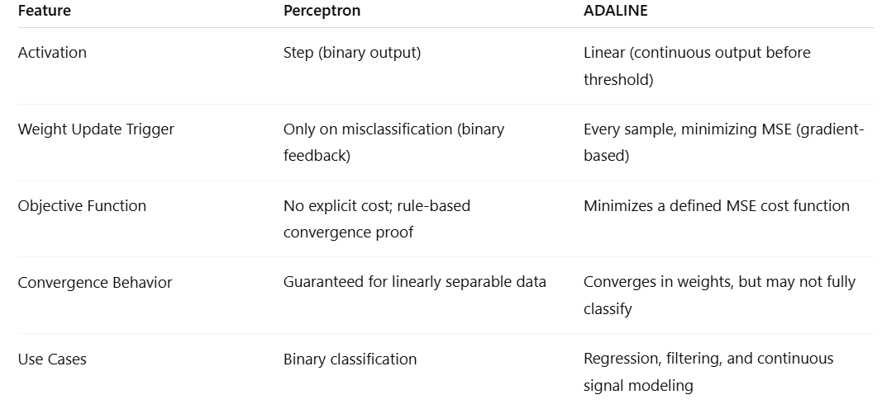

Slide 40
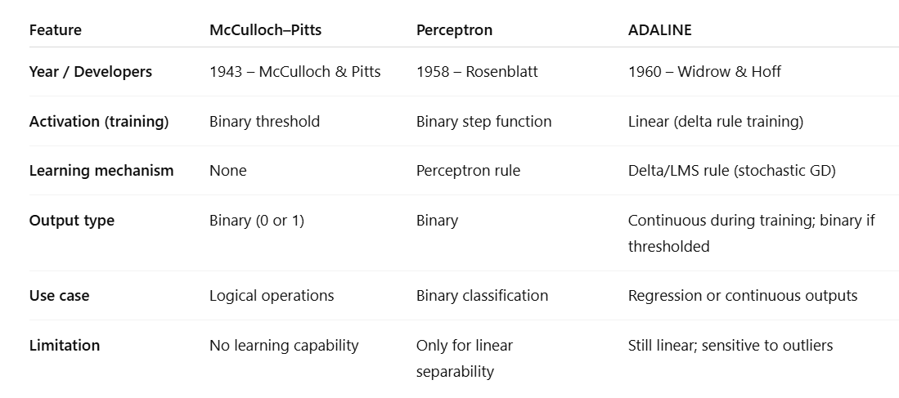

Slide 41
Architectures of Neural Network
Single layer feed-forward neural network
Multi-layer feed forward neural network
Competitive network
Recurrent network

Slide 42
ARCHITECTURES OF NEURAL NETWORK
ANN is a computational system consisting of a large number of interconnected units called artificial neurons. The connection between artificial neurons can transmit signal from one neuron to another.
There are multiple possibilities for connecting the neurons based on which architecture we are going to adopt for a specific solution

Slide 43
ARCHITECTURES OF NEURAL NETWORK
There may be just two layers of neuron in the network – the input and output layer.
Other than the input and output layers, there may be one or more intermediate ‘hidden’ layers of neuron.
The neurons may be connected with one or more of the neurons in the next layer.
The neurons may be connected with all neurons in the next layer.
There may be single or multiple output signals. If there are multiple output signals, they might be connected with each other.
The output from one layer may become input to neurons in the same or preceding layer

Slide 44
Single-layer feed forward network
Single-layer feed forward is the simplest and most basic architecture of ANNs. It consists of only two layers
The input layer of neurons does not conduct any processing – they pass the input signals to the output neurons. The computations are performed only by the neurons in the output layer.
So, though it has two layers of neurons, only one layer is performing the computation. This is the reason why the network is known as single layer in spite of having two layers of neurons

Slide 45

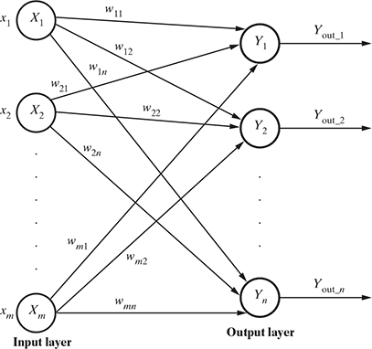
Single-layer feed forward network
The net signal input to the output neurons is given by

Slide 46
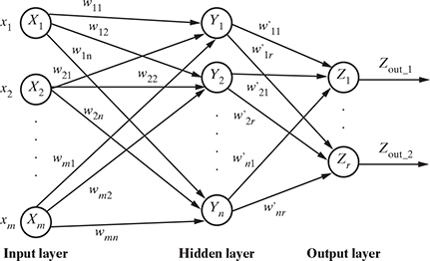
Multi-layer feed forward ANNs
The multi-layer feed forward network is quite similar to the single-layer feed forward network, except for the fact that there are one or more intermediate layers of neurons between the input and the output layers.
Hence, the network is termed as multi-layer

Slide 47
Multi-layer feed forward ANNs
The net signal input to the neuron in the hidden layer is given by
The net signal input to the neuron in the output layer is given by

Slide 48
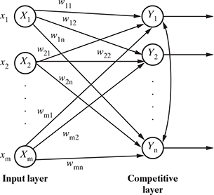
Competitive network
The competitive network is almost the same in structure as the single-layer feed forward network. The only difference is that the output neurons are connected with each other (either partially or fully)

Slide 49
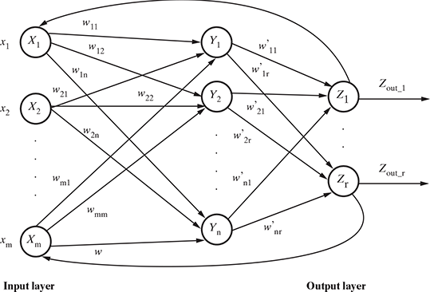
Recurrent network
Signals always flow from the input layer towards the output layer (through the hidden layers in the case of multi-layer feed forward networks), i.e. in one direction. In the case of recurrent neural networks, there is a small deviation

Slide 50
LEARNING PROCESS IN ANN
1. The number of layers in the network
2. The direction of signal flow
3. The number of nodes in each layer
4. The value of weights attached with each interconnection between neurons

Slide 51
BACKPROPAGATION
ANN is to assign the interneuron connection weights. It can be very intense work, more so for the neural networks having a high number of hidden layer or high number of nodes in a layer.
In 1986 an efficient method of training an ANN was discovered, in this method errors, difference in output values of the output layer and the expected values, are propagated back from the output layer to the preceding layer.
Hence the algorithm implementing this method is known as backpropagation.
Propagating the errors backward to the preceding layers

Slide 52
BACKPROPAGATION
The backpropagation algorithm is applicable for multilayer feed forward networks.
It is a supervised learning algorithm which continues adjusting the weights of the connected neurons with an objective to reduce the deviation of the output signal from the target output.
This algorithm consists of multiple iterations, also known as epochs

Slide 53
BACKPROPAGATION
Each epoch consists of two phases –
A forward phase in which the signals flow from the neurons in the input layer to the neurons in the output layer through the hidden layers. The weights of the interconnections and activation functions are used during the flow. In the output layer, the output signals are generated.
A backward phase in which the output signal is compared with the expected value. The computed errors are propagated backwards from the output to the preceding layers. The errors propagated back are used to adjust the interconnection weights between the layers.

Slide 54
BACKPROPAGATION
One main part of the algorithm is adjusting the interconnection weights. This is done using a technique termed as gradient descent.
In simple terms, the algorithm calculates the partial derivative of the activation function by each interconnection weight to identify the ‘gradient’ or extent of change of the weight required to minimize the cost function

Slide 55
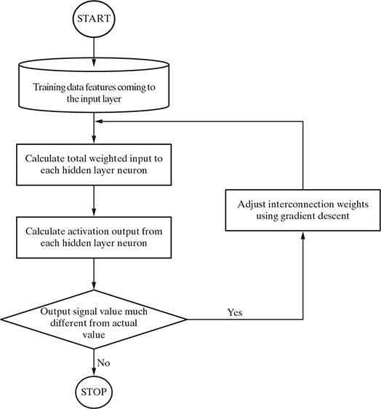
BACKPROPAGATION

Slide 56
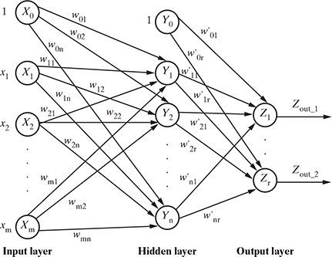
BACKPROPAGATION

Slide 57
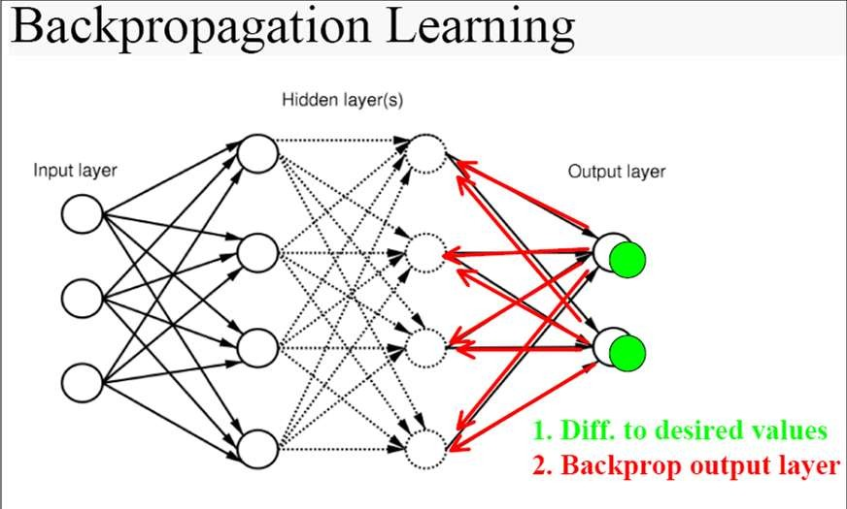
➢Learning is the process of modifying the weights
in order to produce a network that performs some function.

Slide 58
Backpropagation Algorithm
The Backpropagation algorithm learns the weights for a multilayer network, given a network with a fixed set of units and interconnections.
It employs gradient descent to attempt to minimize the squared error between the network output values and the target values for these outputs.

Slide 59
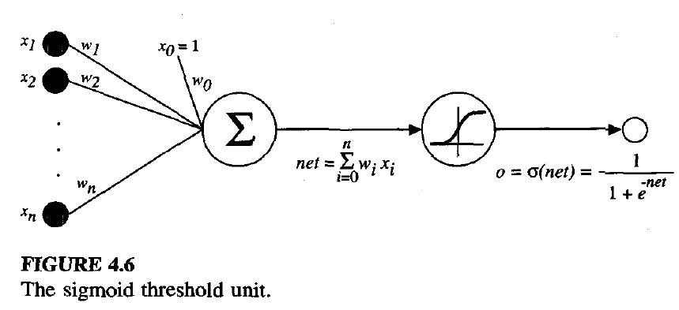
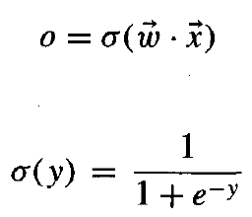

A Differentiable Threshold Unit

Slide 60

Cost Function
Where outputs is the set of output units of the network, t_{kd} and o_{kd} are the target and output values associated with the k^{th} output unit and training example d.

Slide 61
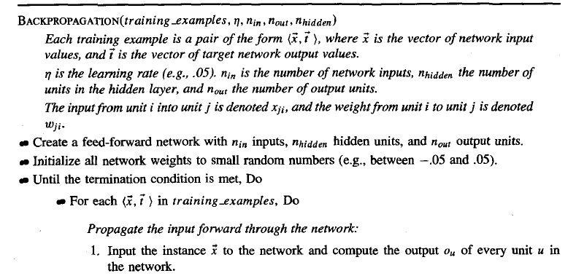
Minimisation of Cost Function and Delta Learning Rule

Slide 62
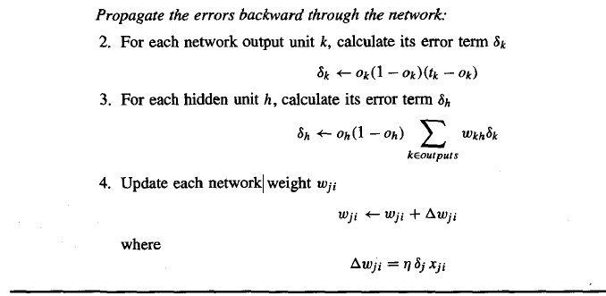

Slide 63

An index (e.g., an integer) is assigned to each node in the network, where a "node" is either an input to the network or the output of some unit in the network.
x_{ji} denotes the input from node i to unit j , and w_{ji} denotes the corresponding weight.
δ_{n} denotes the error term associated with unit n.
It plays a role analogous to the quantity (t - o) in our earlier discussion of the delta training rule.

Slide 64
Two phases: Propagation and Weight update.
Phase 1: Propagation
Each propagation involves the following steps:
Forward propagation of a training pattern's input through the neural network in order to generate the propagation's output activations.
Back propagation of the propagation's output activations through the neural network using the training pattern's target in order to generate the deltas of all output and hidden neurons.

Slide 65
Phase 2: Weight Update
For each weight-synapse:
Multiply its output delta and input activation to get the gradient of the weight.
Bring the weight in the opposite direction of the gradient by subtracting a ratio of it from the weight.
This ratio influences the speed and quality of learning; it is called the learning rate.
The sign of the gradient of a weight indicates where the error is increasing, this is why the weight must be updated in the opposite direction.
Repeat the phase 1 and 2 until the performance of the network is good enough.

Slide 66
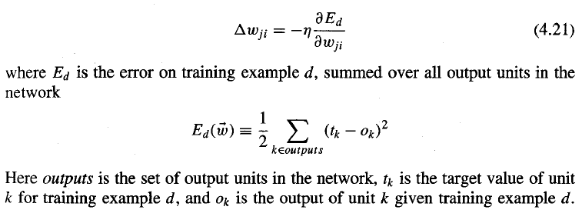
Weight updation in Backpropagation
For each training example d every weight w_{ji} is updated by adding to it ∆w_{ji}

Slide 67
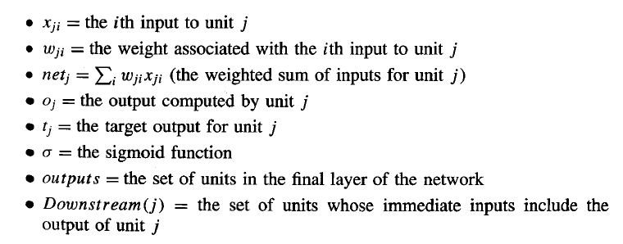
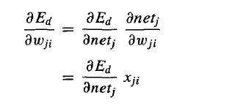

Slide 68
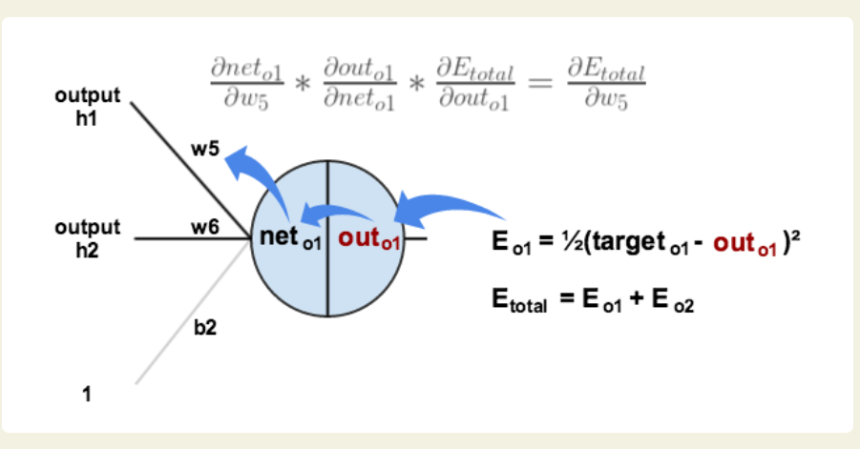

Slide 69
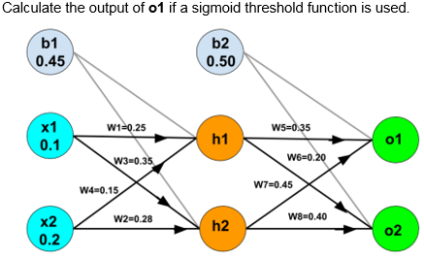
Problem based on ANN:

Slide 70
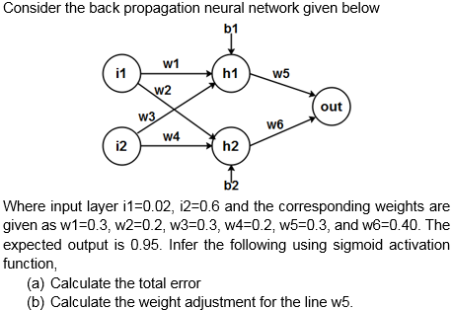
Problem based on ANN

Slide 71
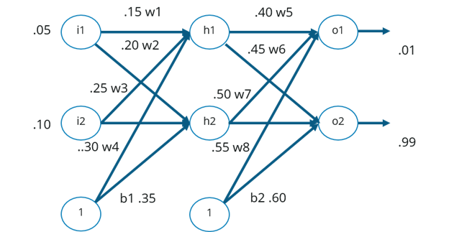

Problem based on ANN:

Slide 72
Strengths
High tolerance to noisy data
Ability to classify untrained patterns
Well-suited for continuous-valued inputs and outputs
Successful on a wide array of real-world data
Algorithms are inherently parallel
Techniques have recently been developed for the extraction of rules from trained neural networks

Slide 73
Weaknesses
Long training time
Require a number of parameters typically best determined empirically, e.g., the network topology or ``structure."
Poor interpretability: Difficult to interpret the symbolic meaning behind the learned weights and of ``hidden units" in the network

Slide 74
What Is Backpropagation? | Training A Neural Network | Edureka
A Step by Step Backpropagation Example – Matt Mazur

